Slide 1

https://goo.gl/e22HYT
https://github.com/aamay001/javascript-fundamentals
Notes:
Hit the green Clone or Download button on the right.
If you have node installed, you’ll be able to run your code live but not required.
These are code samples that I will be showing today. Use your downloaded files to take notes on.

Slide 2
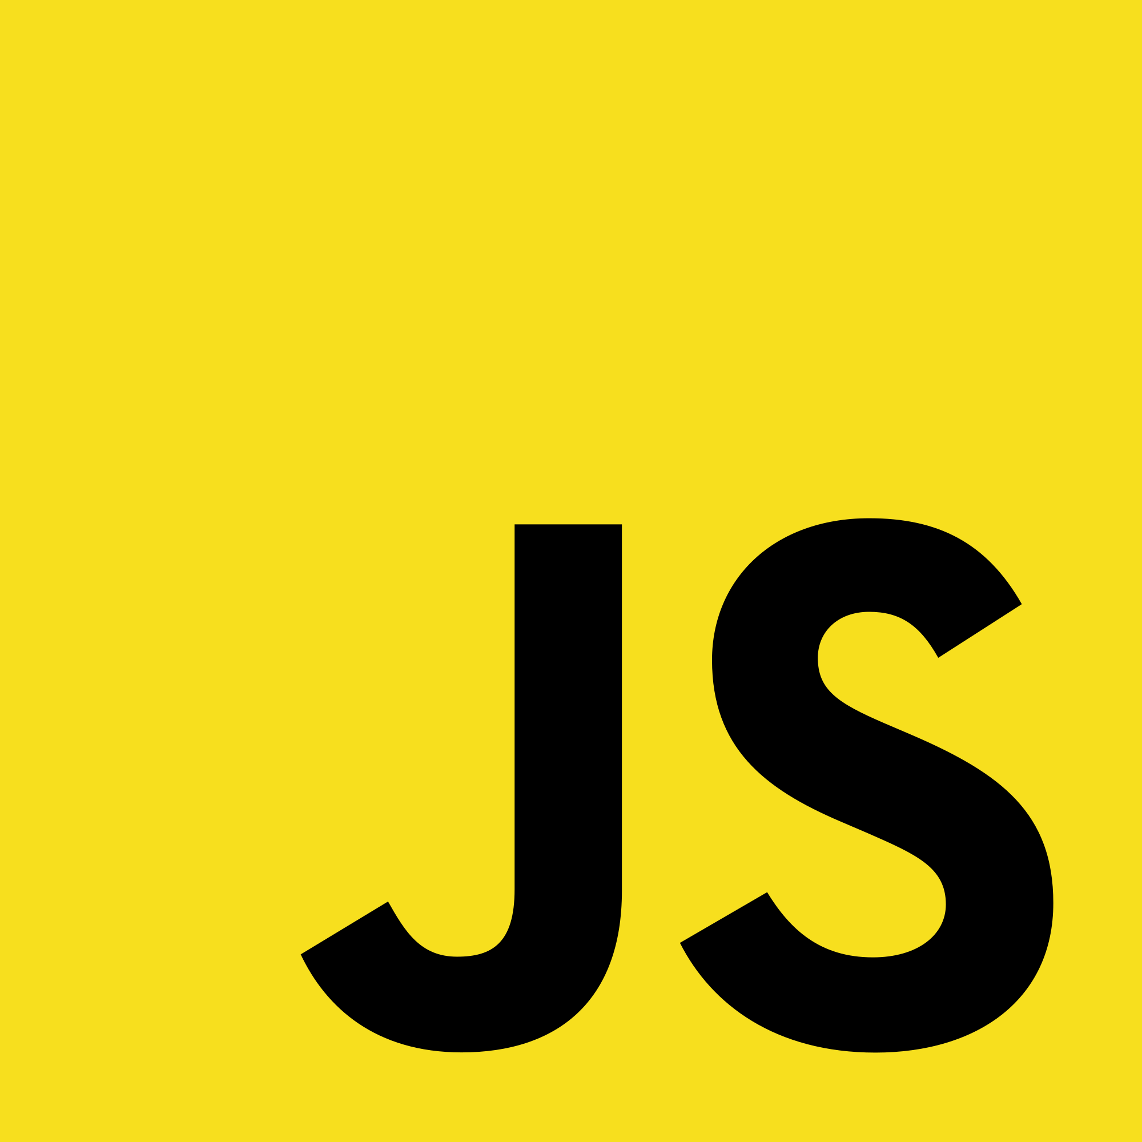
Intro to JavaScript
By Andy Amaya

Slide 3





About Me
Inspired by post on Medium: The Definitive JavaScript Handbook
Full Stack JavaScript Developer (MERN)
MongoDB, Express, React (+ Redux), Node
Long time IT professional/prior Database Analyst
@aamay001
/in/andyamaya
Recent boot camp grad:

Slide 4
Agenda / Topics
A Little About JavaScript
Variables
Functions
Scope and Hoisting
Types – 7 built in types
null vs. undefined
The gotcha’s of the Number type
Equality checking
Falsy and Truthy values
Coercion
’use strict’;
Notes:
An intro to JavaScript geared towards beginners and a strong primer for everyone else. In this talk, I’ll cover a brief theoretical look at JavaScript and an in depth covering of the basics. The talk will go over the 7 built in types, the difference between NULL and undefined, what is meant by coercion and when does it happen, falsy values and truthy values, the gotcha’s of the Number type, equality checking with double and triple equals, scope and hoisting, the different ways you can declare a variable and why you would pick one over the other, functions and how you declare them (why use one over the other), and what ‘strict mode’ is good for. Each topic will be briefly covered

Slide 5

A Little About JavaScript
Developed in the mid 90’s
Brendan Eich; Father of JavaScript
NetScape Hired Brandan to Develop JS
First version was developed in 10 days
Originally named Mocha, then LiveScript
Renamed to ride on the popularity of Java
Dynamically typed language
Notes:
NetScape was the popular browser of the time. HTML was in it’s infancy and there was no suck thing as dynamic web pages. The founders of NetScape, dreamed about having a lightweight scripting language that would allow them to manipulate the DOM.
During this time there was a lot of competition to bring this type of technology to life and Brendan had very little time develop a prototype.
Eventually there was a deal between NetScape and Sun Microsystems to rename to JavaScript. During this time Java was becoming very popular.

Slide 6
Variables
Variables can be declared using 3 keywords, or no keyword
var
let
const
Variable name (no preceding keyword)
Variables have scope
Variables are a named unit of memory used to store some value
Variables declared with var or no keyword are hoisted
Don’t declare variables without a keyword

Slide 7
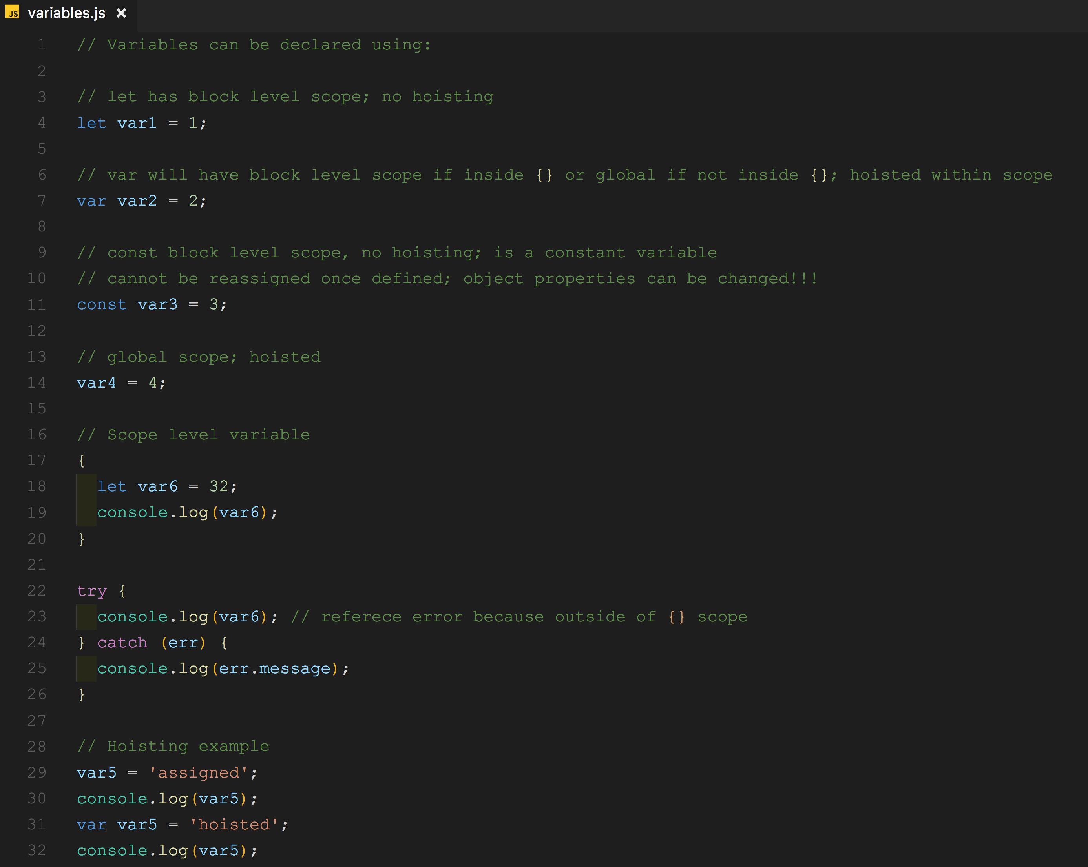

Slide 8
Functions
Blocks of code that can be called and executed on demand
Functions can de defined two way
Function expression
Are not hoisted
Can only be called after execution reached code
Function declaration
Are hoisted
Can be called before and after declaration

Slide 9
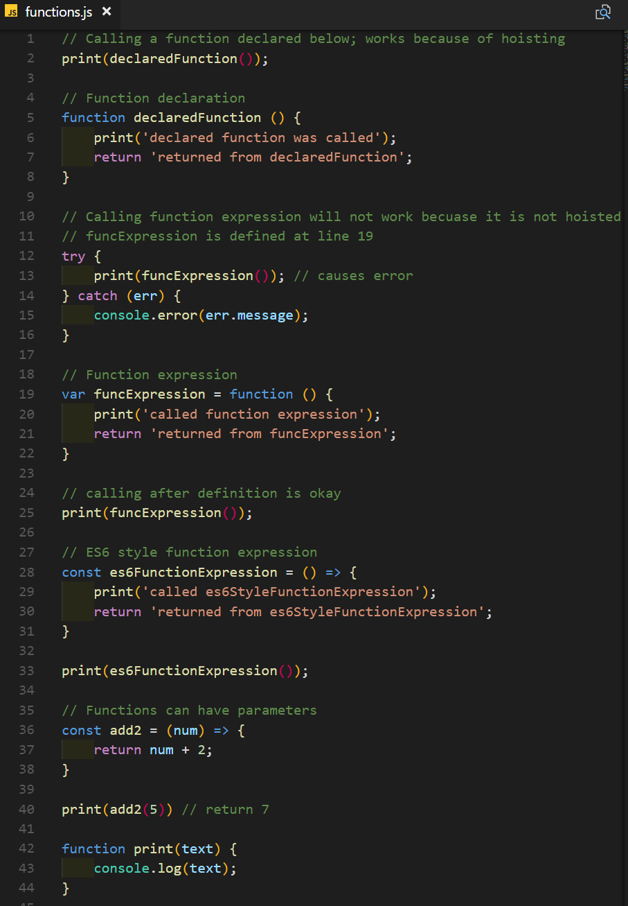

Slide 10
Scope and Hoisting
Scope is defined by the opening and closing of curly braces
{
}
Scope defines the execution context
There are two types of scope
Global: variables and functions declared in global scope can be accessed inside of any other scope.
Local: variables and functions inside a local scope can only be accessed within this scope and any nested scopes
Hoisting of variables and functions will happen within their execution context (i.e. scope)

Slide 11
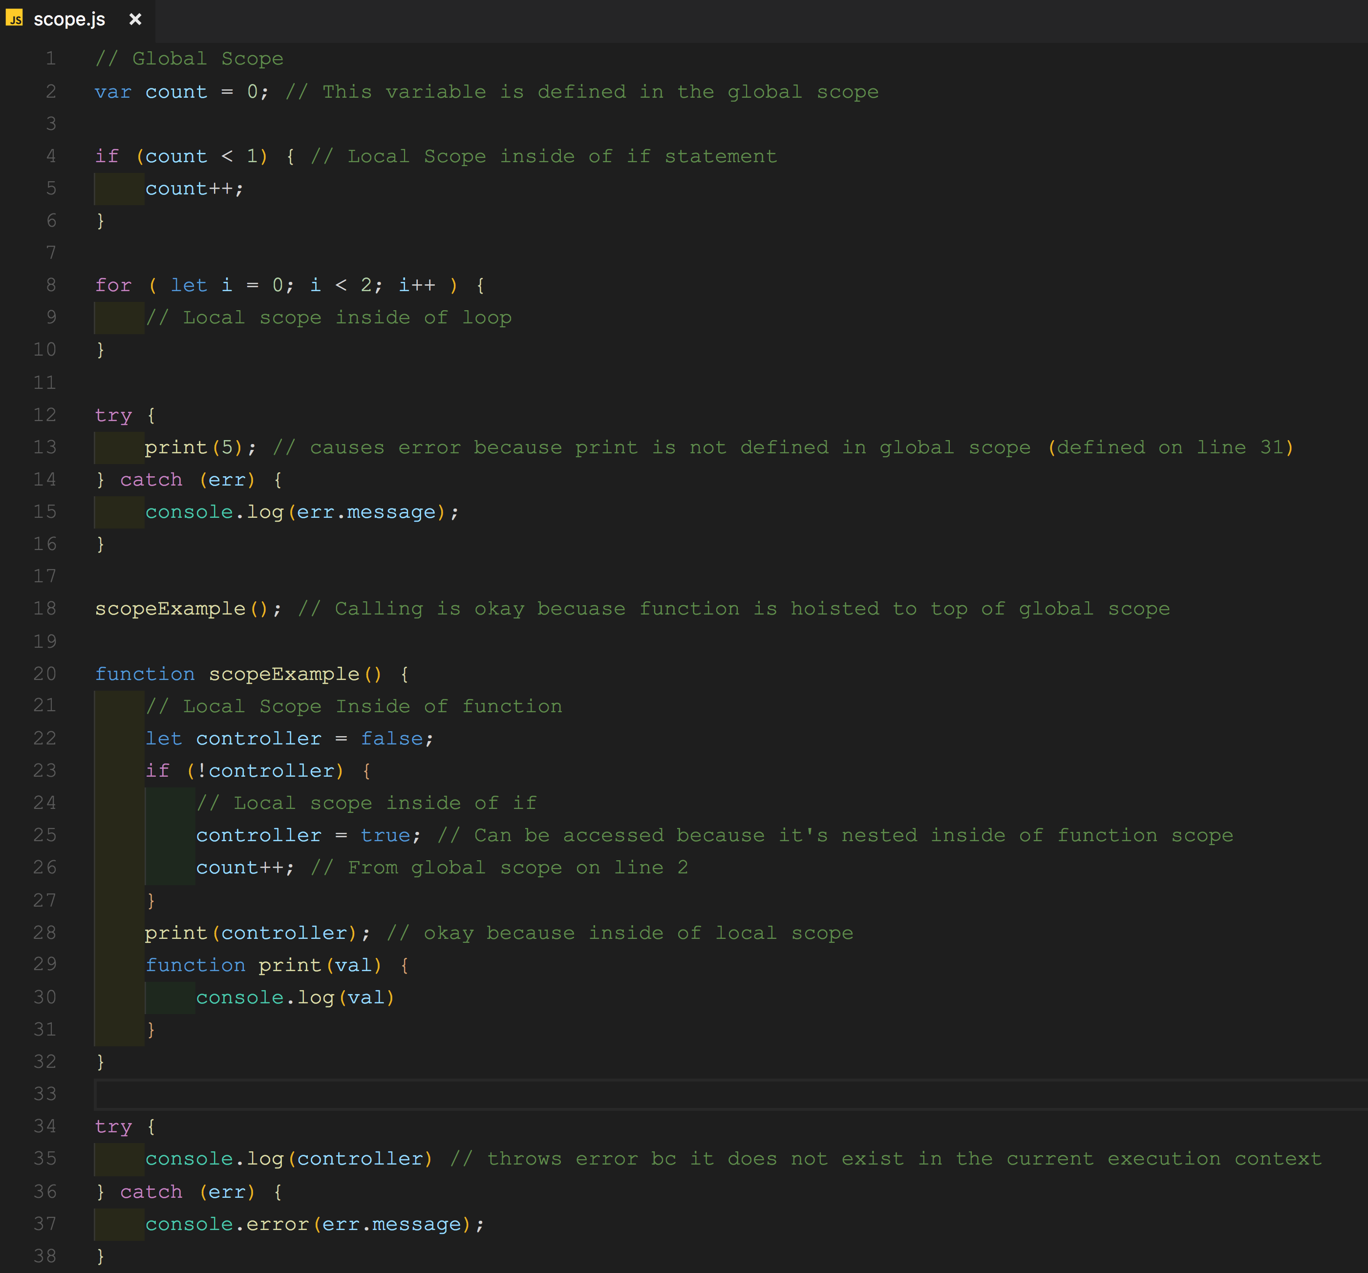

Slide 12
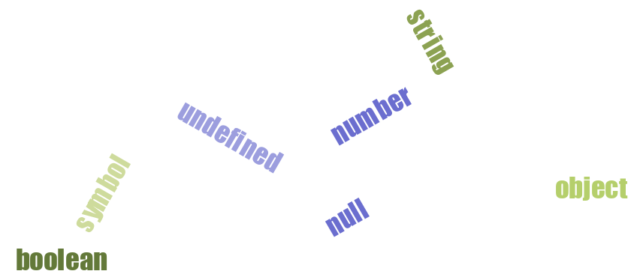
JavaScript Types
Six data types that are primitives:
boolean
null
undefined
number
string
symbol (new in ES 6)
and object
Notes:
7 Built in JavaScript Types

Slide 13
undefined
Absence of a definition.
Is default value of uninitialized variables
Is the value of function parameters when value is not provided
Value of any missing properties in objects
Is the default return value of a function that returns nothing

Slide 14
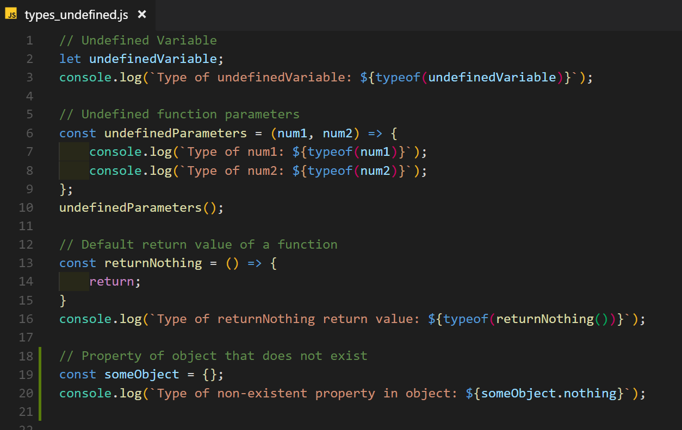
Notes:
All return undefined.

Slide 15

null
Is the absence of a value
Null is an assignment value
Type of a null is object
It’s a type and a value
null expresses a lack of identification, indicating that a variable points to no object

Slide 16
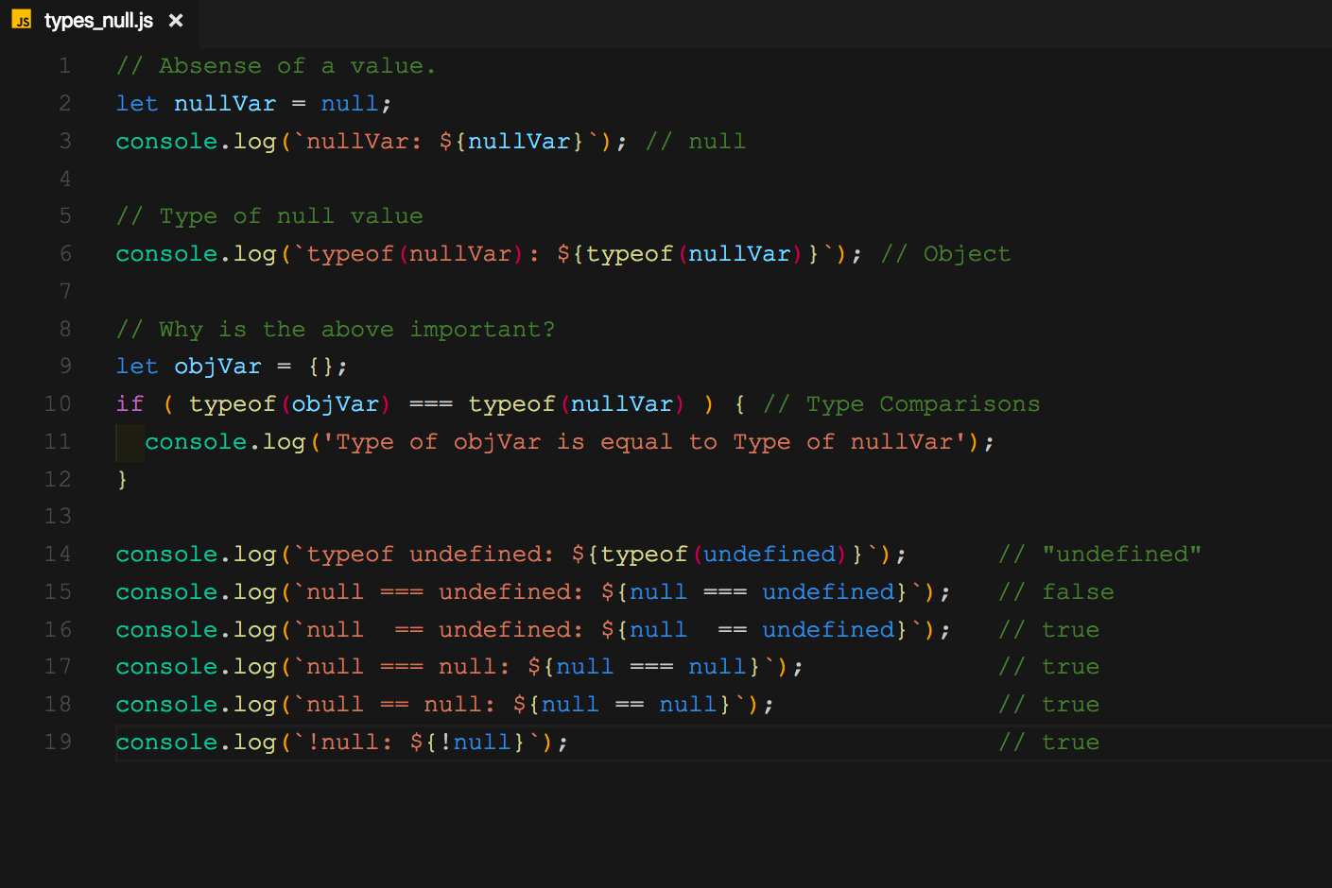

Slide 17
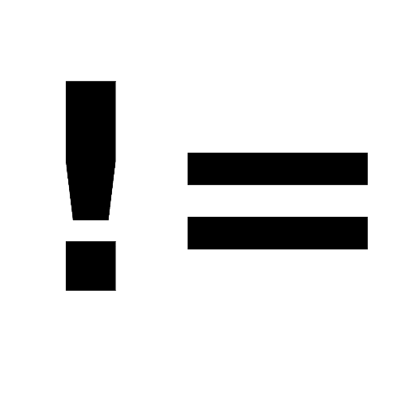
null vs undefined
Undefined is the absence of a definition.
Null is the absence of a value.
They are not strictly equal to each other.
They are coercively equal to each other
Notes:
http://dorey.github.io/JavaScript-Equality-Table/

Slide 18
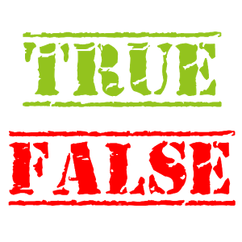
boolean
Logical data type
Can only have two values
true
false
Generally used to make a decision using
loops
if statements

Slide 19
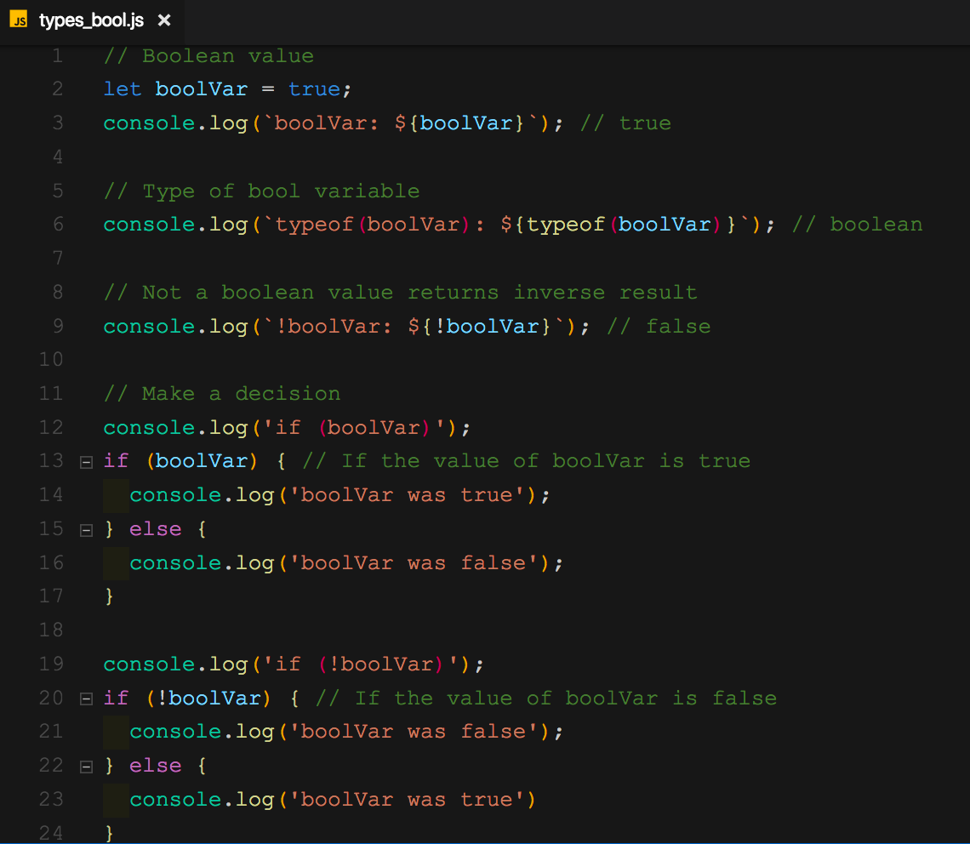

Slide 20
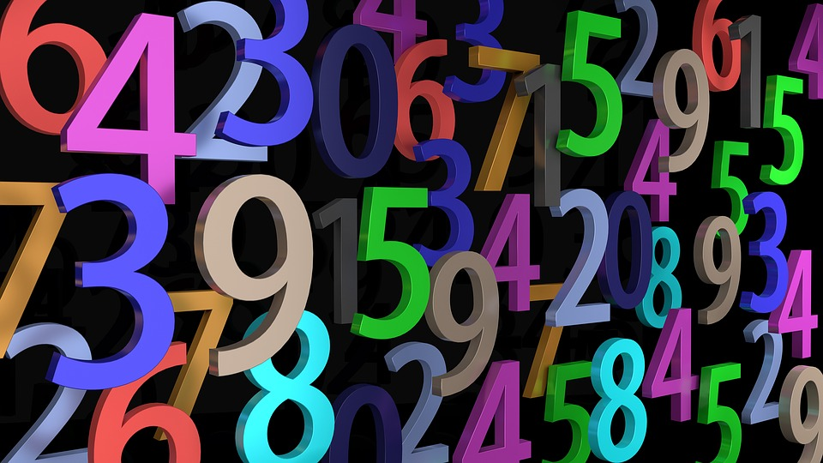
number
Only native number type
Signed double precision type
64-bit binary format
Based on the IEEE 754 standard
Range (-2⁵³ -1) to (2⁵³ -1)
Used to store integers and floating point value
Has 3 symbolic values
Infinity
–Infinity
NaN

Slide 21
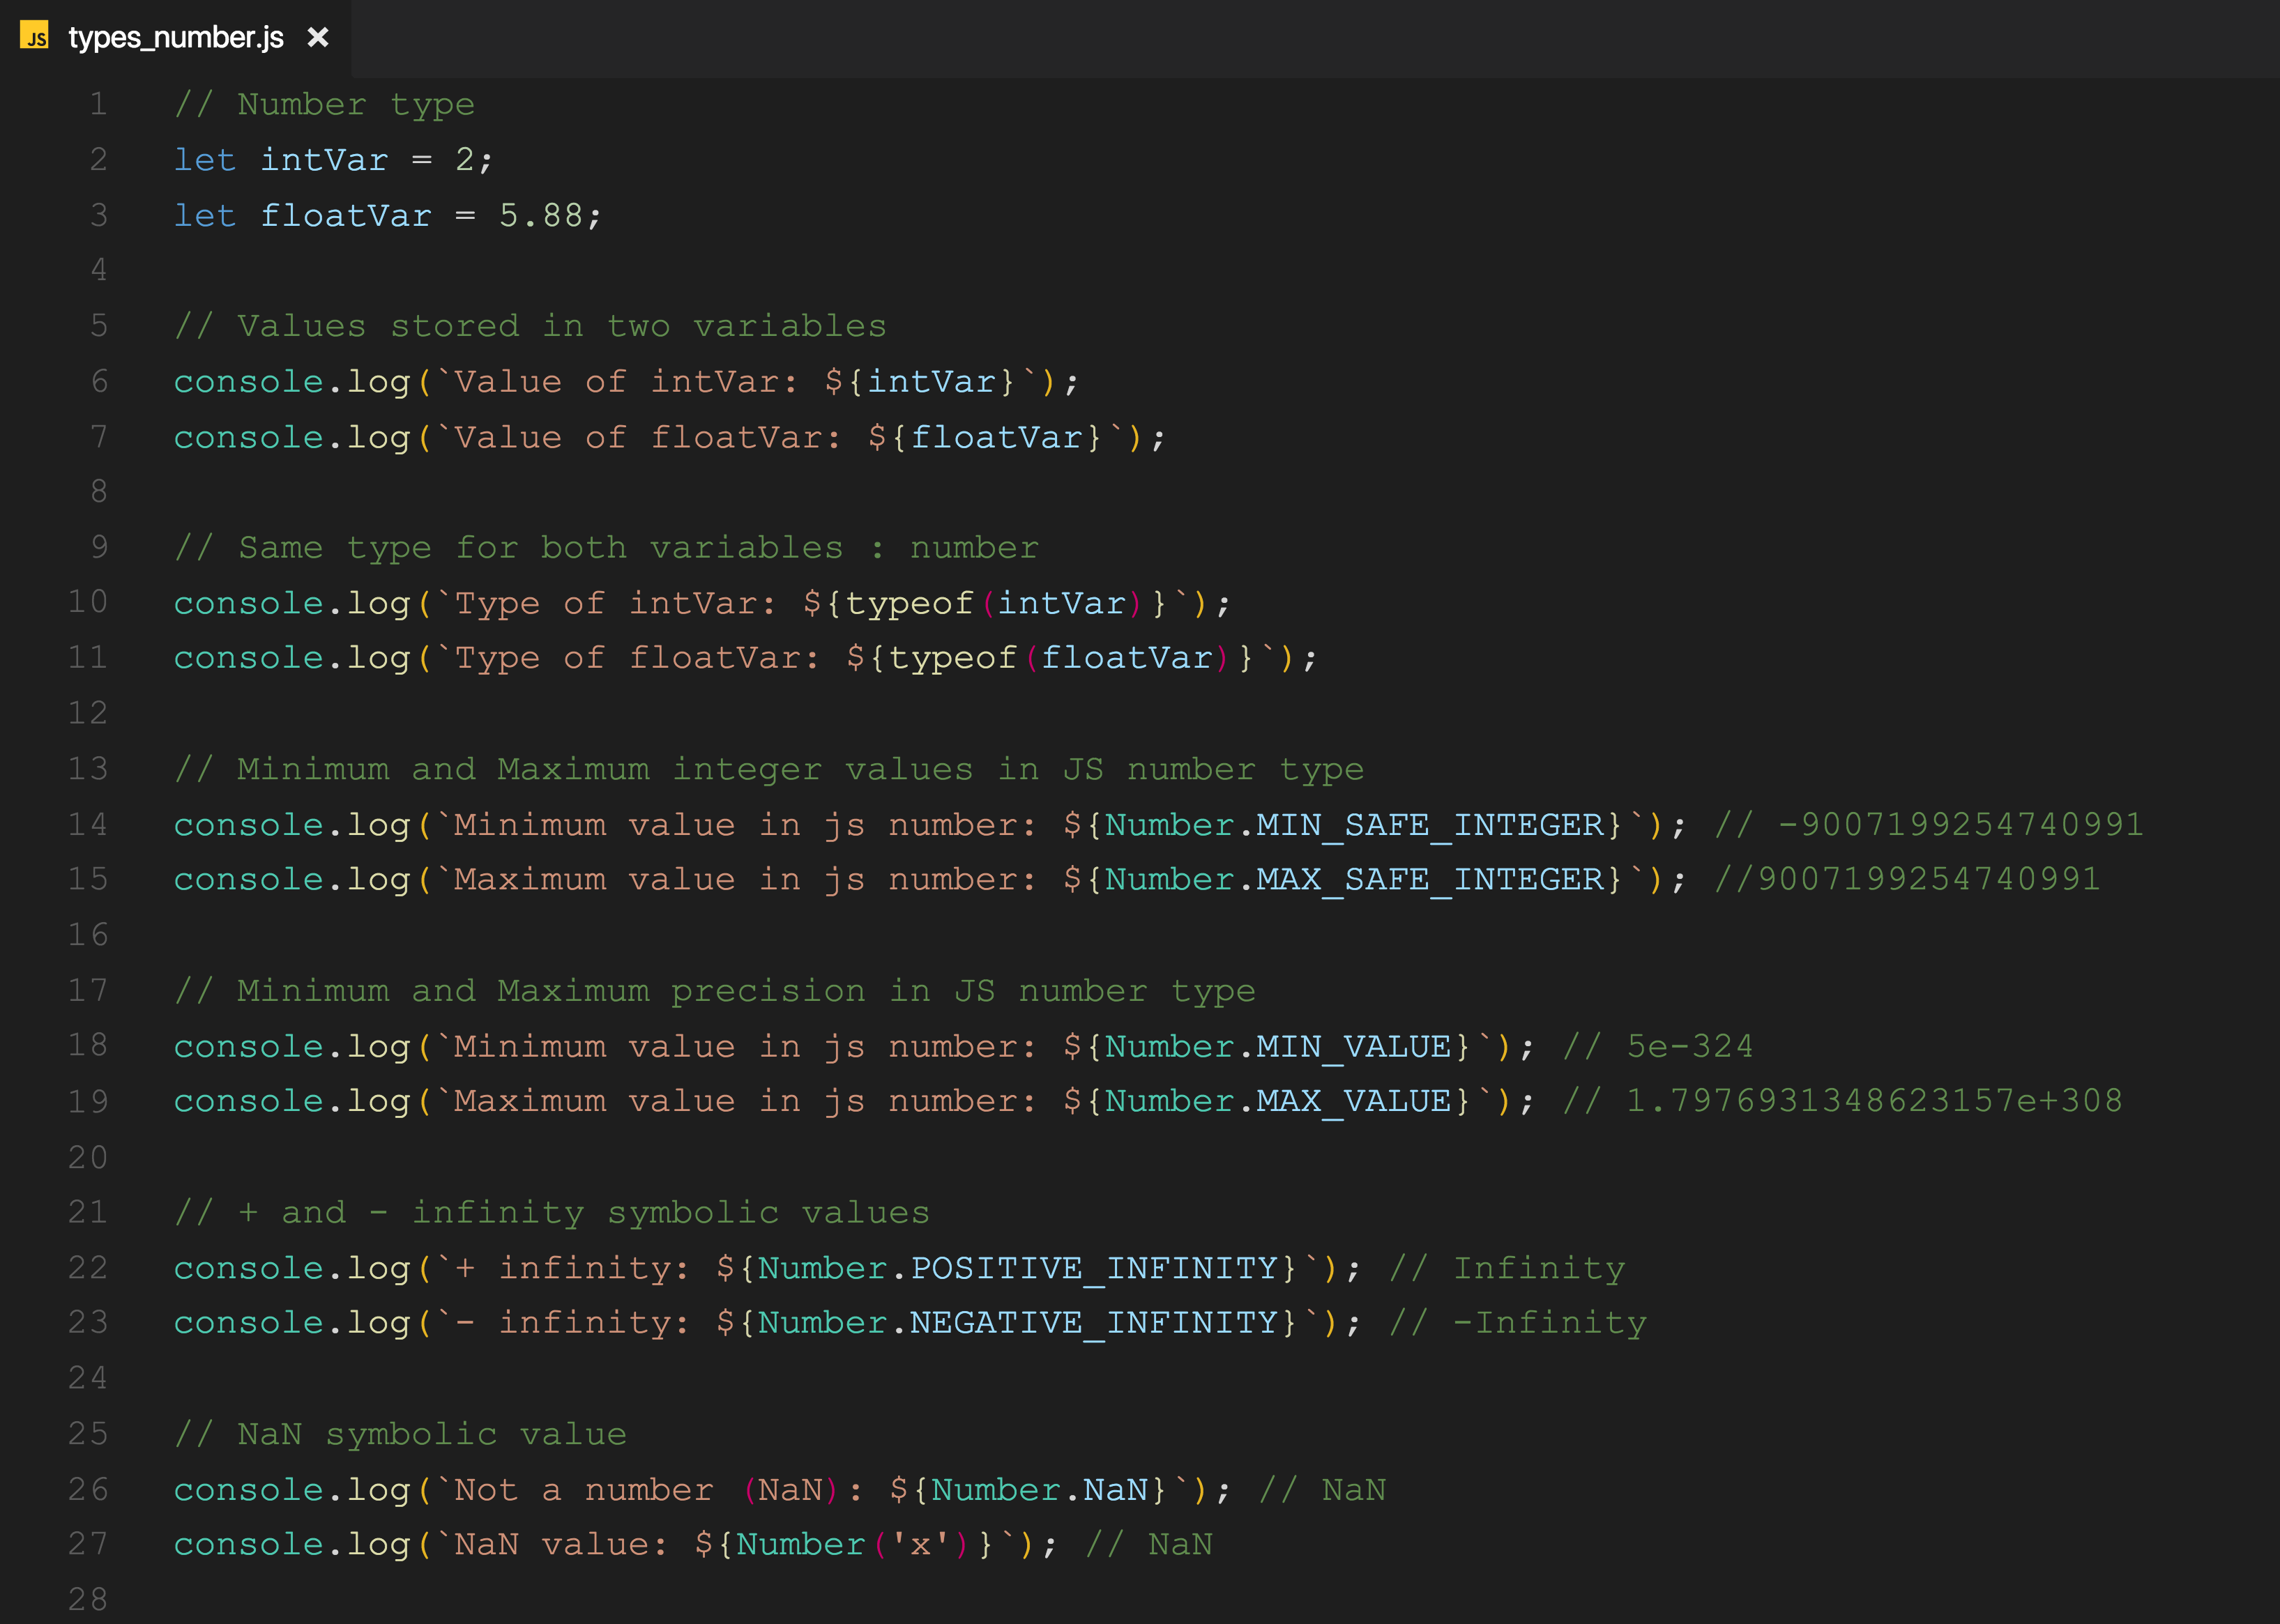
Notes:
Important to note. When you start dealing with really large numbers, it’s important to remember that values become representations.
The stored values will not display as fully expanded numbers; they will display as exponential notation

Slide 22
number type gotcha
Displaying large numbers
JavaScript number display algorithm
Use exponential notation if there are more than 21 digits before the decimal point.
Use exponential notation if the number starts with “0.” followed by more than five zeros
2.56788e256 3.0000e-3
Notes:
http://2ality.com/2012/03/displaying-numbers.html

Slide 23

string
Used to represent textual data
Strings in JavaScript are immutable
Once created, cannot be modified
Self assignment creates a copy
You can use 3 character to create string
“ – Double Quote (quotation)
‘ – Single Quote (apostrophe)
` - Back tick

Slide 24
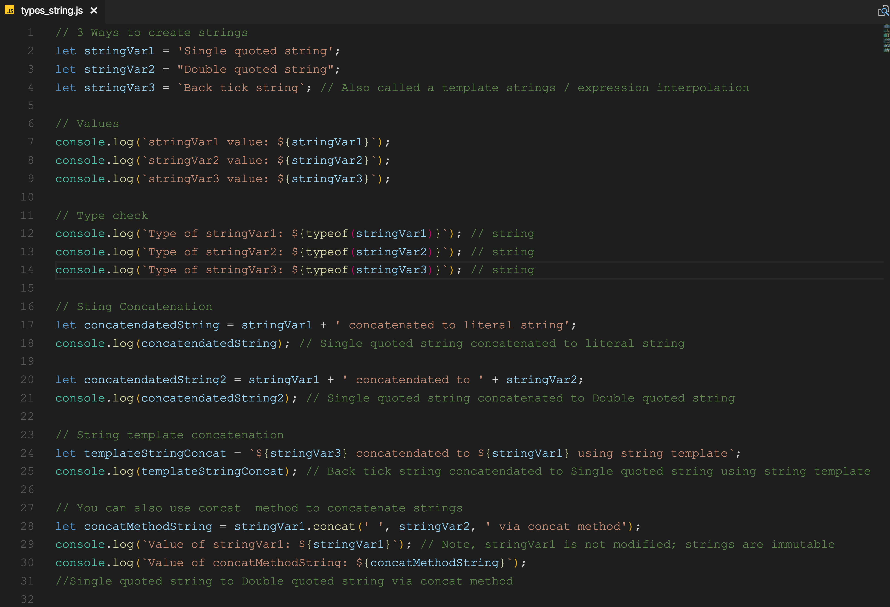

Slide 25
object
An object is a standalone entity, with properties and type
Properties have a name (or key) and contain a value
The value of a property can be a function; called methods
In JavaScript, and object is simple a collection (array) of key and value pairs
Much like a dictionary or a map in order languages
Can be created with object initializers or constructor
Object initializers can be considered literal notation
Useful for modeling real life objects
Example: car, has color, make, model, etc

Slide 26
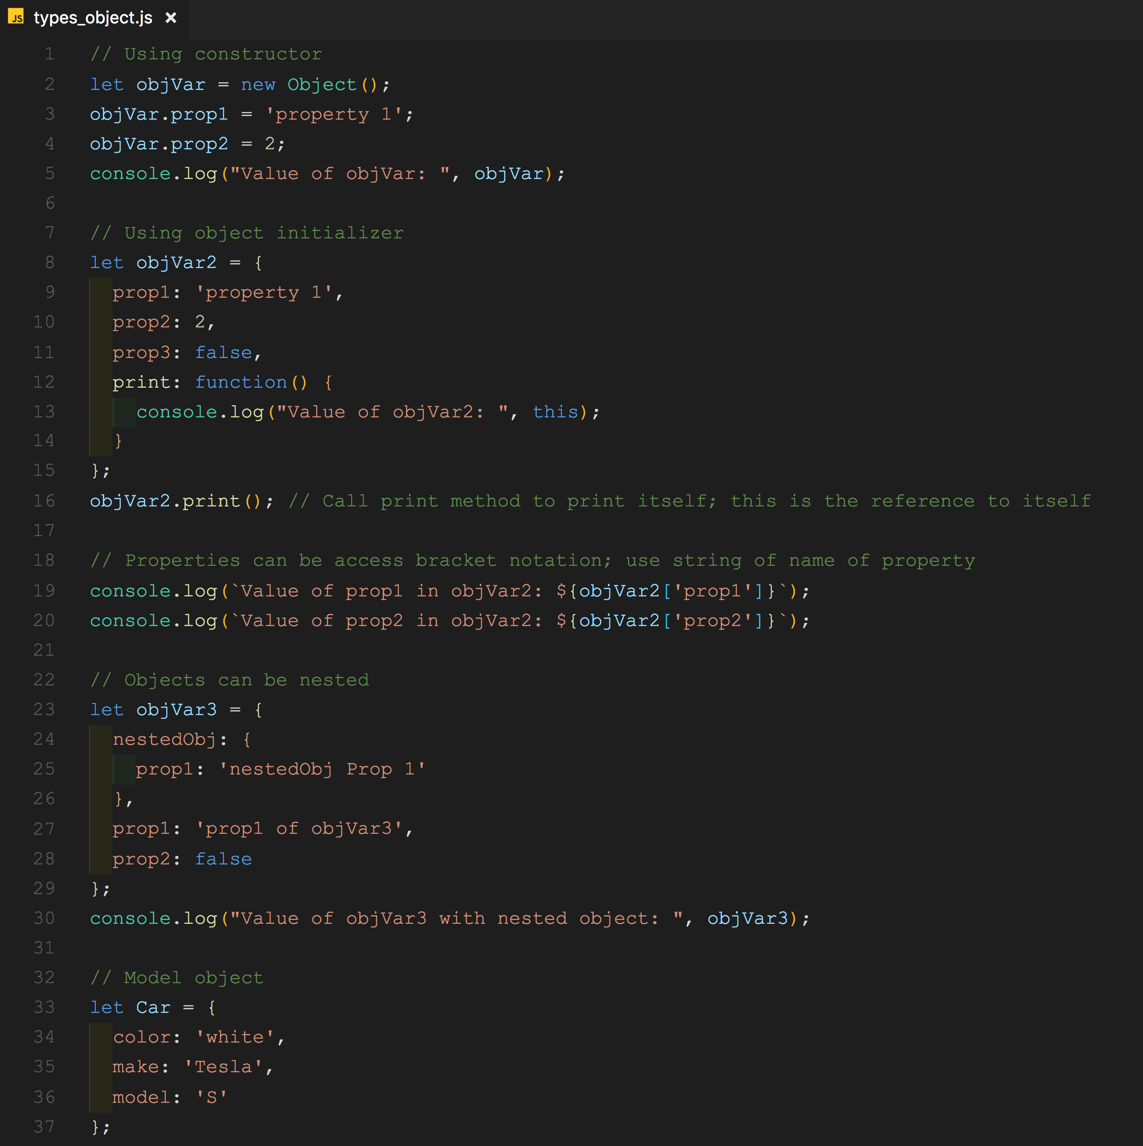

Slide 27
Symbol (new to ES6)
Just an honorable mention
Use Symbol function to create a unique value
Every return value from Symbol is unique
May be used as an identifier for object properties
This is the only purpose according to the MDN docs
Notes:
https://developer.mozilla.org/en-US/docs/Web/JavaScript/Reference/Global_Objects/Symbol

Slide 28
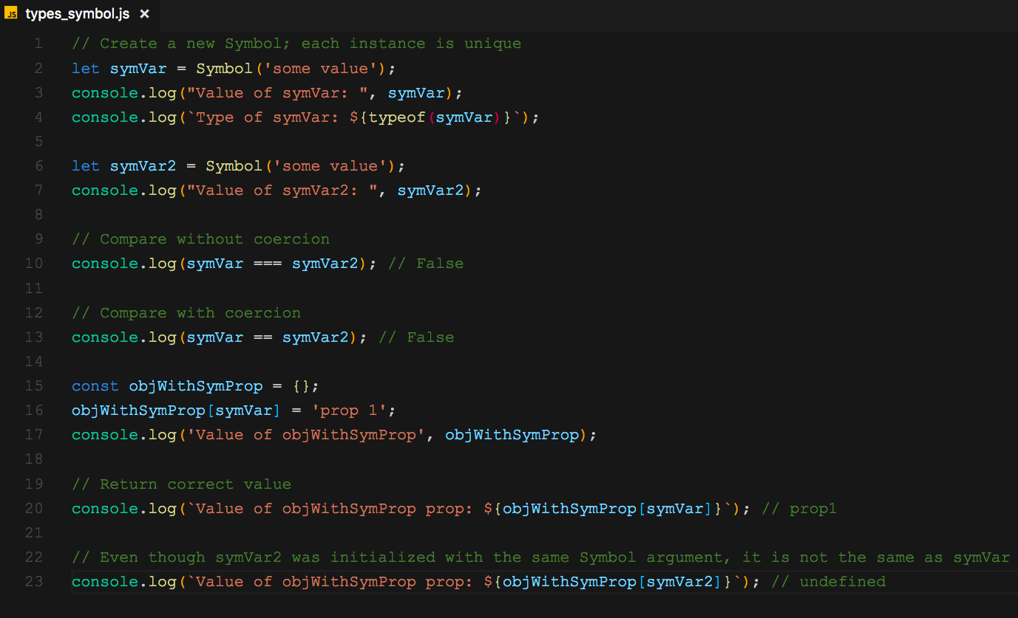

Slide 29
Equality Checking (and coercion)
JavaScript has two ways of checking for equality.
== AND/OR !=
=== AND/OR !==
=== : Checks for equality without coercion (strictly equal)
== : Checks for equality with coercion
See resources for comparison table
Always use ===
Coercion is implicit type casting
Notes:
Converting a value from one type to another is often called “type casting,” when done explicitly, and “coercion” when done implicitly (forced by the rules of how a value is used).
JavaScript coercions always result in one of the primitive types, like string, number, or Boolean
Coercion is implicit type casting (vs explicit)

Slide 30
Falsy and Truthy Values
always falsy: (will always evaluate to false in a logical check)
false
0 (zero)
'' or "" (empty string)
null
undefined
NaN
All other values, are truthy
‘0’ : string with value zero
‘false’ : string with value false
[] , {} : empty array or object

Slide 31
“use strict”;
Strict Mode directive
tightens the rules for parsing and error handling on your code
Benefits
Makes debugging easier
Eliminates some JavaScript silent errors by changing them to throw errors
Prevents accidental global variables
Prevents duplicate property names or parameter values
Helps prevent side effects
+ more
To enable strict mode
‘use strict’; // at top of your js file
Notes:
Advanced programming securities
Prevents invalid use of delete keyword
Makes eval function safer
Eliminates coercion of ‘this’

Slide 32
That’s it! Thanks!
@aamay001
/in/andyamaya

